Slide 1
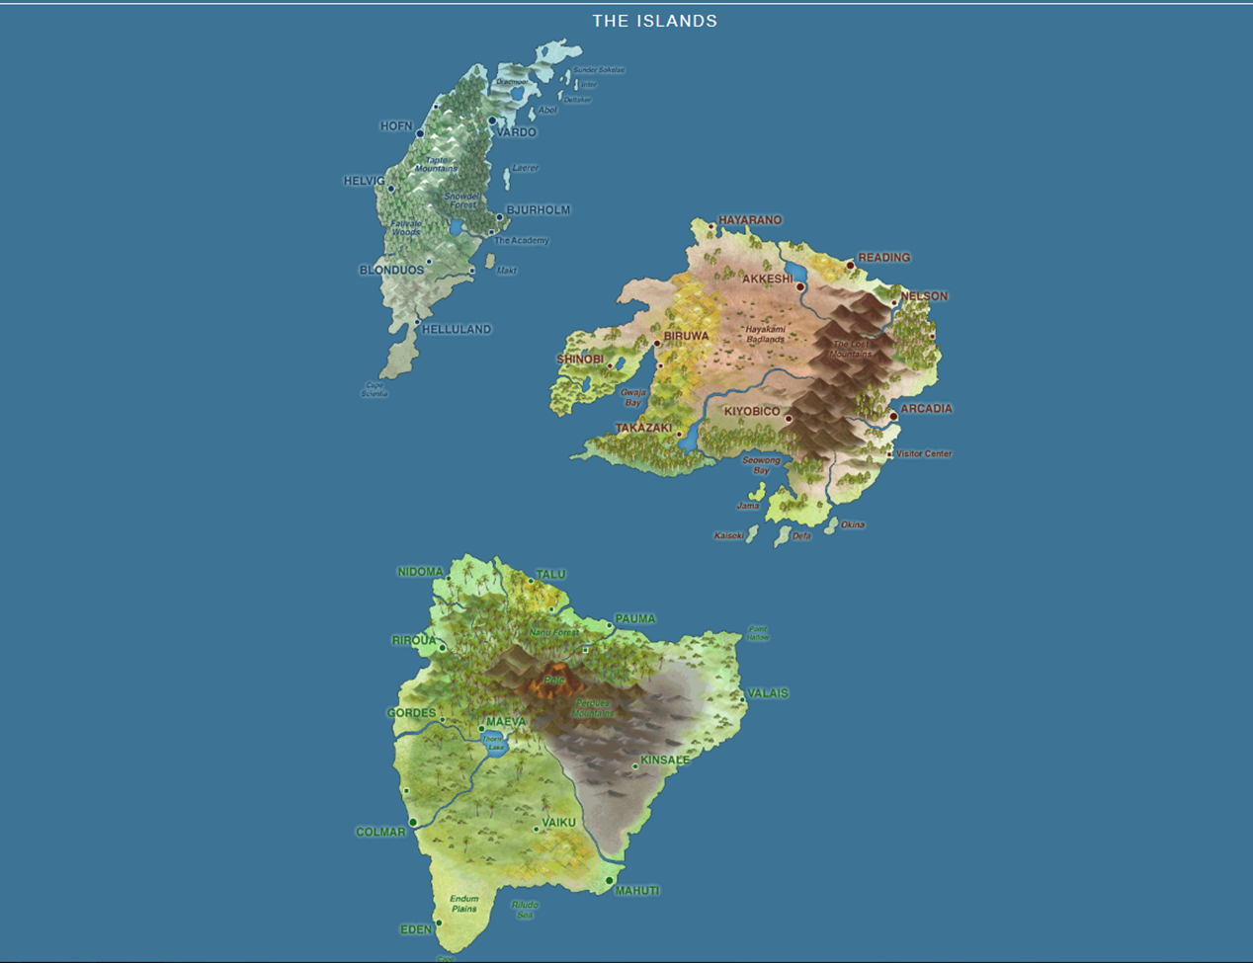
Using the Islands in an Introductory Statistics Course
Carl Clark, PhD
Rita Lindsay, PhD
Indian River State College
18 January 2019

Slide 2
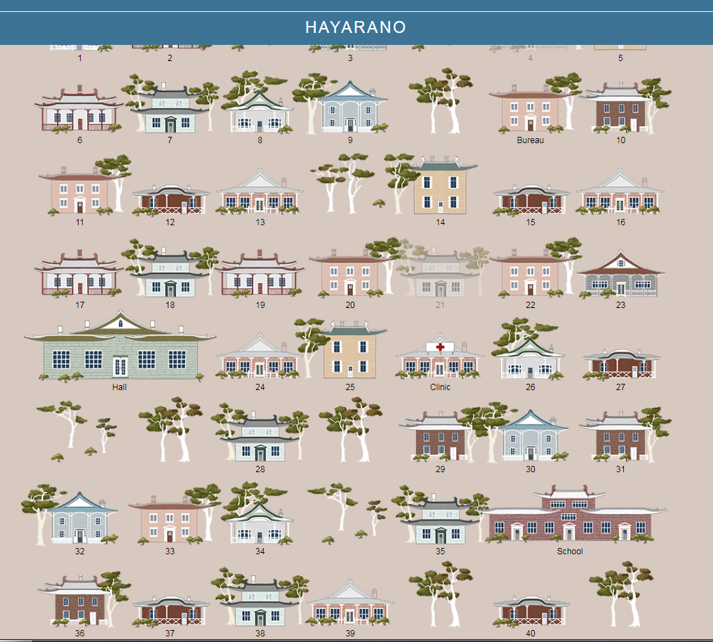

Slide 3
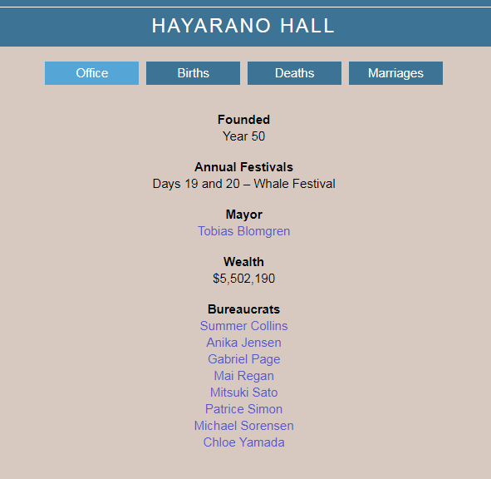
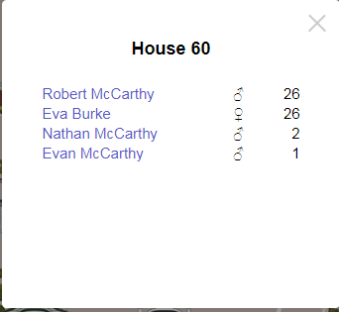
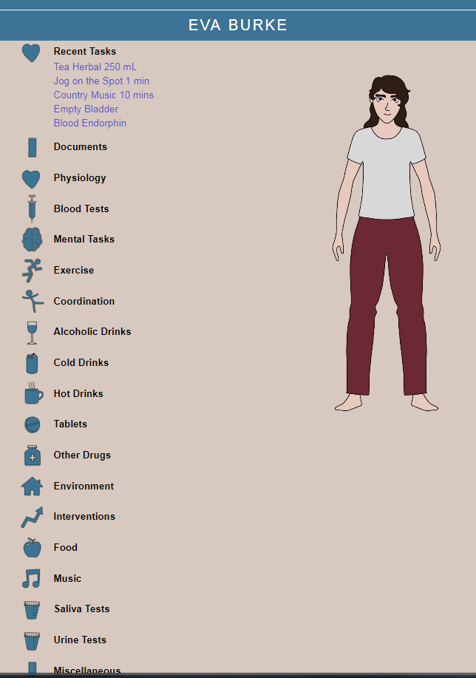
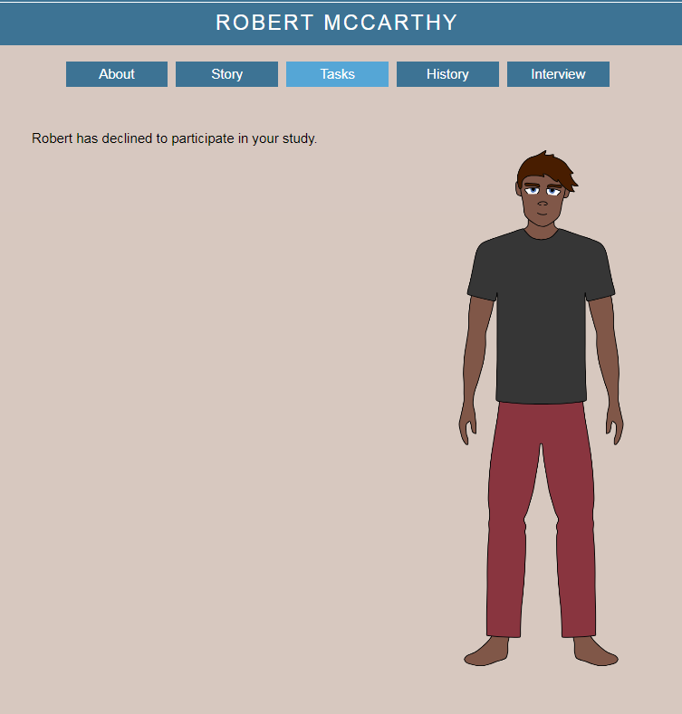

Slide 4
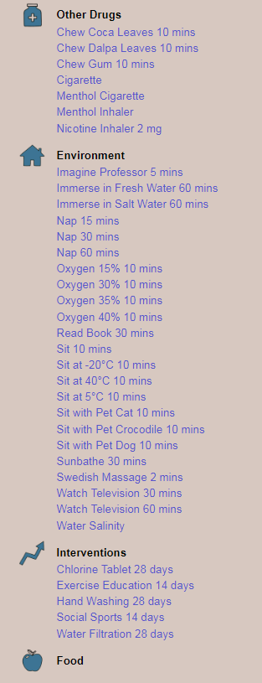
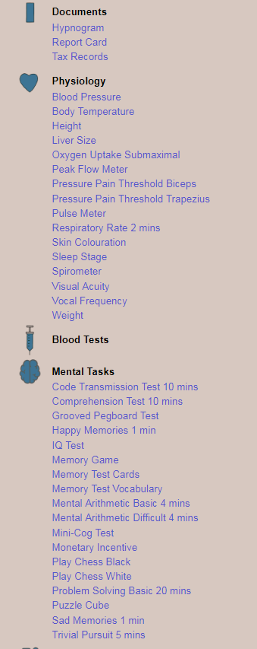

Slide 5
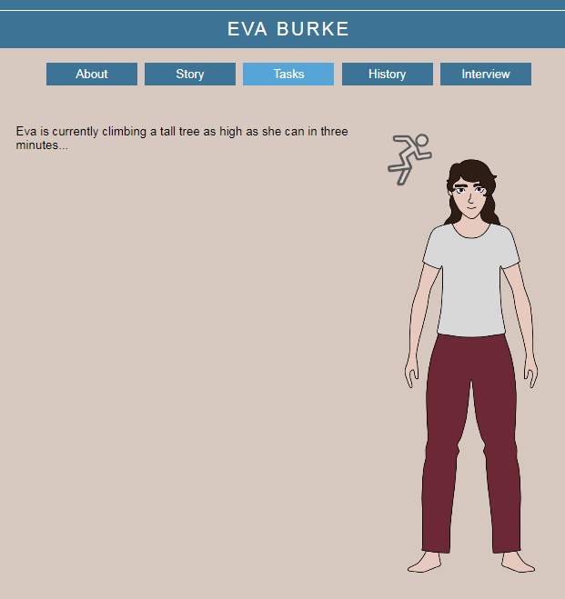
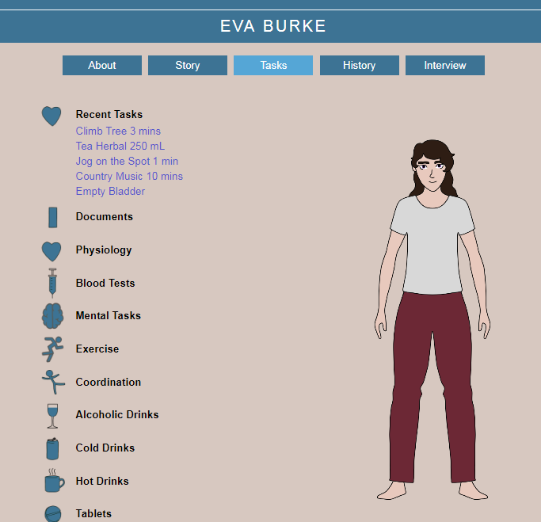
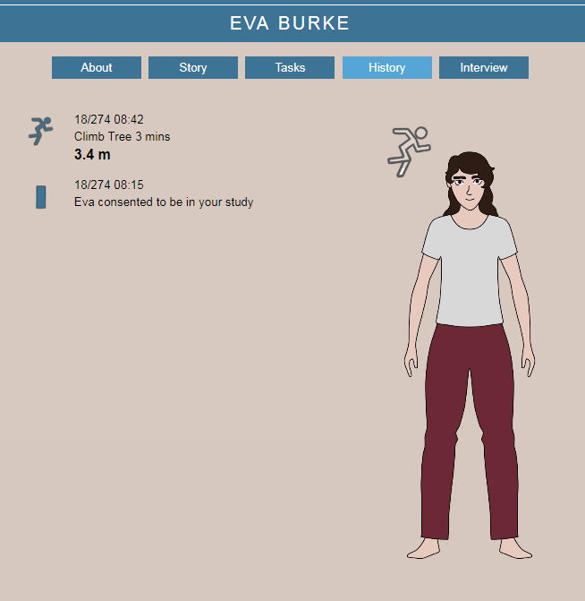

Slide 6
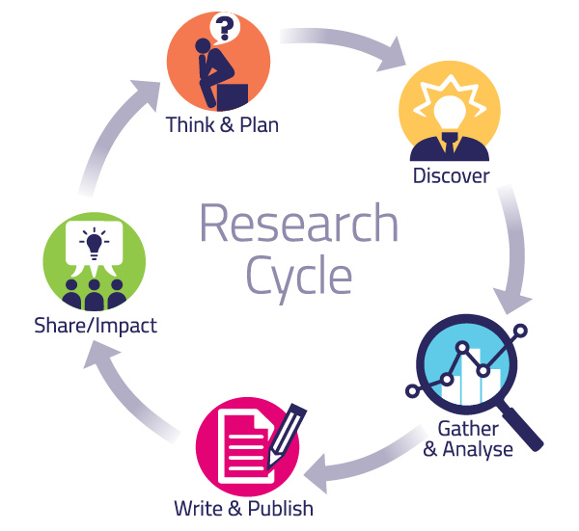
Curriculum
Proposal Process
Sampling Techniques
Gathering Data
Organizing Data
Analysis
Reporting

Slide 7
Questions

Slide 8
Resources
https://sites.google.com/site/islandsinschoolsprojectwebsite/
https://cclark-irsc.weebly.com/jmm-2019.html

